Slide 1
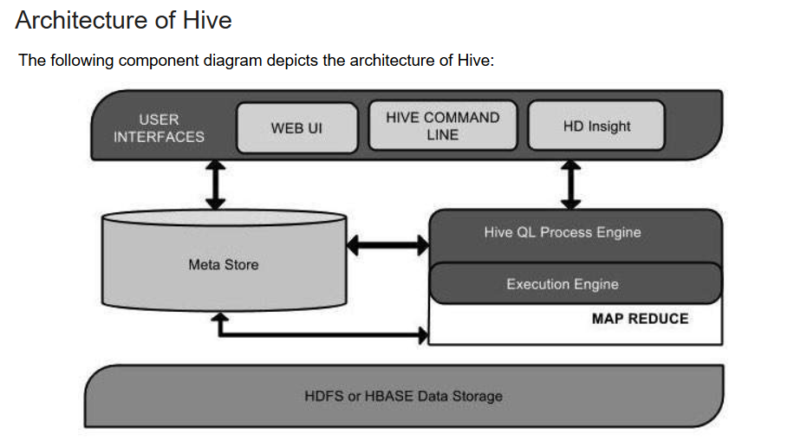

Slide 2
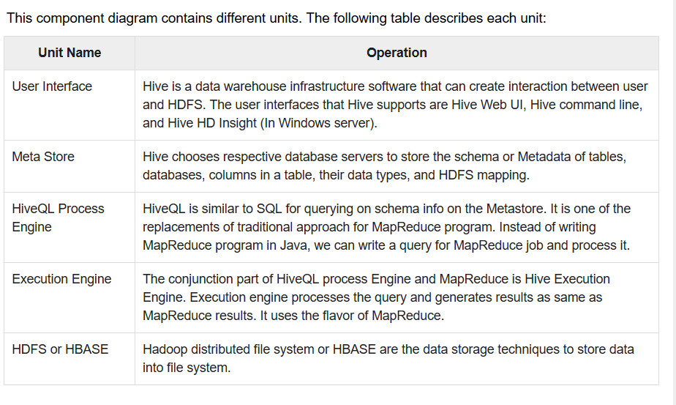

Slide 3
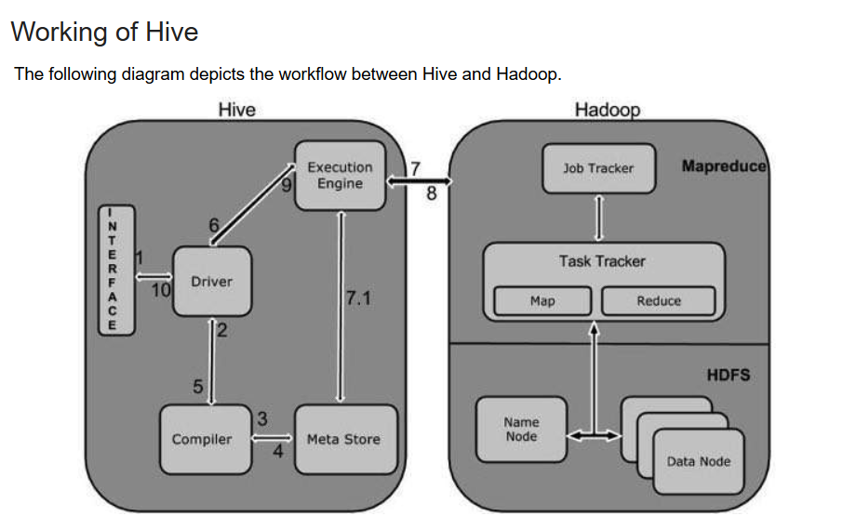

Slide 4
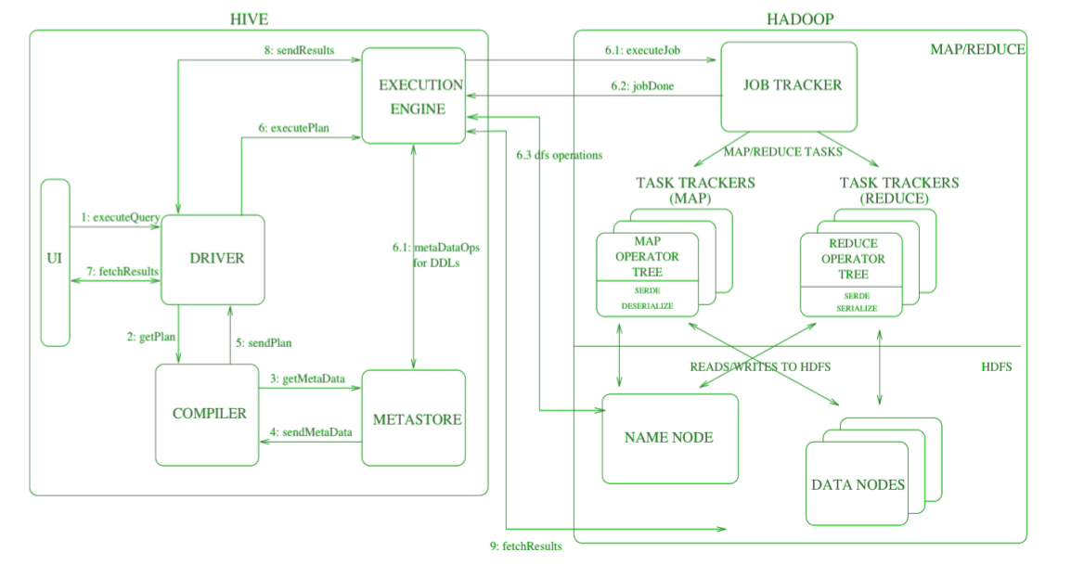

Slide 5
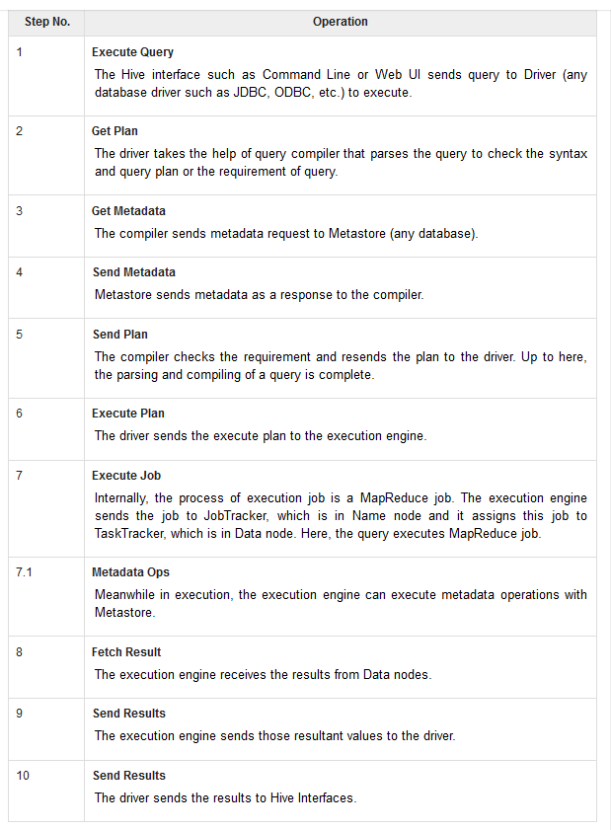

Slide 6
The file name says file1 contains client data table:
tab1/clientdata/file1
id, name, dept, yoj
1, sunny, SC, 2009
2, animesh, HR, 2009
3, sumeer, SC, 2010
4, sarthak, TP, 2010
Now, let us partition above data into two files using years tab1/clientdata/2009/file2
1, sunny, SC, 2009
2, animesh, HR, 2009
tab1/clientdata/2010/file3
3, sumeer, SC, 2010
4, sarthak, TP, 2010

Slide 7
CREATE TABLE studentTab (id INT, name STRING, dept STRING, yoj INT) PARTITIONED BY (year STRING);
LOAD DATA LOCAL INPATH tab1’/clientdata/2009/file2’OVERWRITE INTO TABLE studentTab PARTITION (year='2009');
LOAD DATA LOCAL INPATH tab1’/clientdata/2010/file3’OVERWRITE INTO TABLE studentTab PARTITION (year='2010');

Slide 8
Adding a Partition
ALTER TABLE table_name ADD [IF NOT EXISTS] PARTITION partition_spec [LOCATION 'location1'] partition_spec [LOCATION 'location2'] ...;
partition_spec: : (p_column = p_col_value, p_column = p_col_value, ...)
hive> ALTER TABLE StudentTab > ADD PARTITION (year=’2009’) > location '/2009/part2009';
Renaming a Partition
ALTER TABLE table_name PARTITION partition_spec RENAME TO PARTITION partition_spec;
hive> ALTER TABLE employee PARTITION (year=’1203’) > RENAME TO PARTITION (Yoj=’1203’);

Slide 9
HBase Commands
A list of HBase commands are given below.
Create: Creates a new table identified by 'table1' and Column Family identified by 'colf'.
Put: Inserts a new record into the table with row identified by 'row‘.
Scan: returns the data stored in table
Get: Returns the records matching the row identifier provided in the table
Help: Get a list of commands

Slide 10
create 'table1', 'colf'
list 'table1'
put 'table1', 'row1', 'colf:a', 'value1'
put 'table1', 'row1', 'colf:b', 'value2'
put 'table1', 'row2', 'colf:a', 'value3'
scan 'table1'
get 'table1', 'row1'

Slide 11
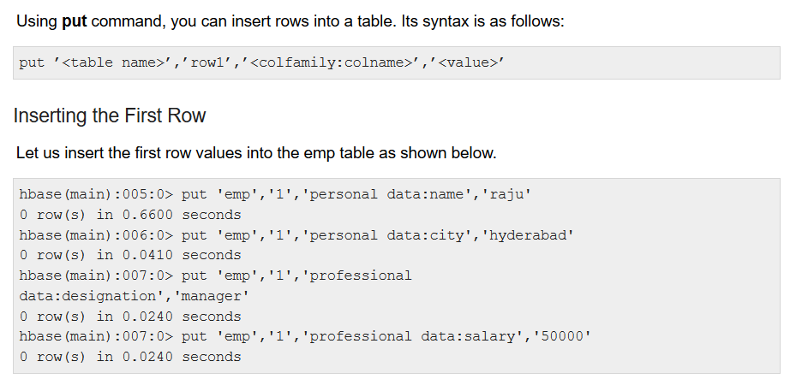
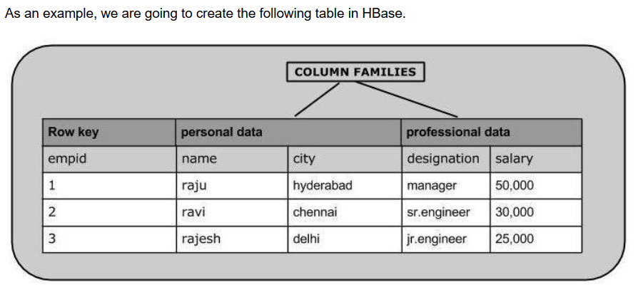

Slide 12
